Slide 1
The African School of Fundamental Physics and Applications (ASP)
Dr. Kétévi Adiklè Assamagan
Brookhaven National Laboratory (BNL)
Upton, New York USA
https://www.africanschoolofphysics.org/
ASP-IOC@CERN.CH

Slide 2
Personal
I am Dr. Kétévi A. Assamagan
  Member of the International Organizing Committee (IOC) of ASP
  Born in Gabon
  Originally from Togo and Ghana (father side), and Bénin (mother side)
  Naturalized US Citizen
Education
  “License en Physique et Chimie”, Université de Lomé
  Ph.D., University of Virginia, USA
    Ph.D. thesis done at Paul Scherrer Institute in Switzerland
  Post-doctoral Studies at Hampton University (USA), Jefferson Lab (USA), and CERN (Switzerland)
Profession
  Physicist (tenured) at Brookhaven National Laboratory (USA)
  Visiting Researcher at CEA-SACLAY (France)
  Visiting Researcher at the University of Johannesburg (South Africa)
  Research Interests: search for new physics beyond the Standard Model of particle physics
    I am a member of the ATLAS Collaboration that discovered the Higgs Boson
  I organize my own professional physics workshop. Next one on October 2-5, 2018 at BNL
    www.bnl.gov/di2018
Civil Status
  Married
  My wife runs the ASP mentorship program
  My daughter wants to be drain surgeon
  They are here
Hobbies
  African drums, Djembe in particular. I used to travel to physics conferences with my Djembes
  Writer. My first novel: “Citizen and Traveler (2017)” with French translation “Citoyen et Voyageur (2018)”. Available in www.azamon.com in paperback and e-book

Slide 3
Overview
ASP2018
Fifth Edition in Namibia
June 24 to July 14, 2018
523 Applications and 85 students
selected from 26 countries
Expansion
- Pupils Outreach
(30 schools, 1500 learners, 1 week)
- Teachers Workshop (63 teachers, 1 week)
- Professional Physics Conference (1 week)
ASP2020 Morocco
Host countries selected
2.5 years earlier
through a bidding process
ASP2010
First Edition in South Africa
August 1-21, 2010
125 Applications and 65 selected
from 17 countries
Serious efforts to advertise widely
ASP Mentorship / Coaching Program
Introduced since 2016. Runs continuously.
Permanent assistance to students even
when there is no formal school
ASP2016
Fourth Edition in Rwanda
August 1-19, 2016
429 Applications and 80 students
selected from 28 countries
Expansion:
- Pupils Outreach added
(3 schools, 150 pupils, 3 days)
- Teachers Workshop Added
(20, 2 days)
ASP2012
Second Edition in Ghana
July 15 to August 8, 2012
138 Applications and 50 students
selected from 15 countries
ASP2014
Third Edition in Senegal
August 3-23, 2014
330 Applications and 70 students
selected from 21 countries
Feedbacks to improve future ASPs

Slide 4
Organization
Objective:
Increase capacity development in fundamental physics and related applications in Africa
International Advisory Committee (IAC)
Representatives of funding agencies
Advise on the program
Advise of the host country selection
Local Organizing Committee (LOC) – in the host country
Local logistics
Liaise with Education and Research branches of host country government
International Organizing Committee (IOC)
Overall management
Fund raising
Coordination of activities
Assessment of Impact
Survey of students
Survey of their Professors
Follow academic developments
Spin-Offs
ASP Mentorship/Coaching Program
Networking and sharing of information
Align ASP with educational priorities
Improve future editions of ASP
Promote research collaborations
Promote research consortia
International Lecturers (IL)
Design the scientific Program
Help with the student selections
Mentor and Coach students continuously

Slide 5
Scientific Program
ASP Conference
1-week International Conference
Participation of ASP Alumni
Participation of Research Faculties
Networking and collaborations
Fundamental Physics and Applications
Astrophysics and Cosmology;
Nuclear and Particle Physics;
Accelerator, Medical and Radiation Physics;
High Performance Computing;
Renewable Energies and Energy Efficiency;
Material Physics.
High School Teachers Program
1-week intensive workshop
Train High School Teachers for improved physics teaching
Student Program
3-week intensive school
3rd year of University to Ph.D.
Mostly African Students
70-80 Students
Learners Program
1-week learners Outreach
10-12th grade learners
Encourage learners to develop and maintain interests in Physics and Applications
Mentorship / Coaching Program
At all times
Work with Academic Advisors
Connect Students with Researchers
Place students at Laboratories
Listen to students and help address their academic needs if possible

Slide 6
ASP2018 Students Profile
523 Applications
Total Selected: 85
There were 30 good students on the waiting list
  Selections constrained by budget and logistics
  Replace early declinations

Slide 7

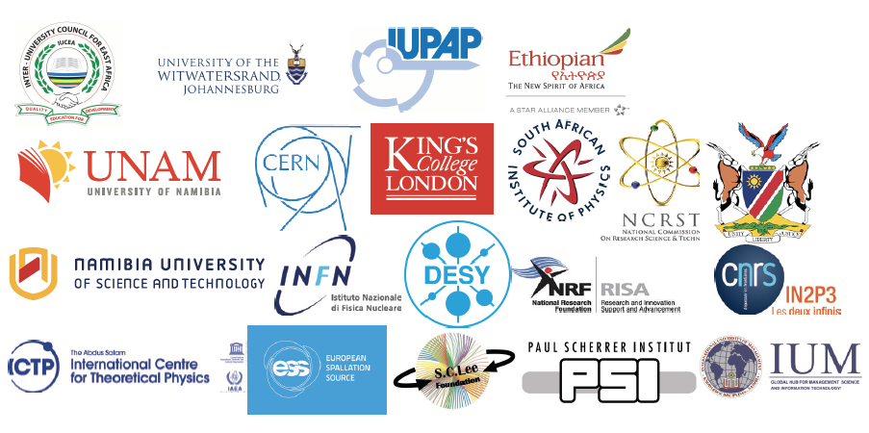
Sponsorships for Student Participations
“If each African country supports its participants, or contributes 2500 Euros every year to the ASP budget,
ASP will be entirely financed by African countries. And *2500 Euros* is marginal even for the least developed country”
ASP2018 Sponsors in addition to USA DOE Labs (BNL)
African Contributors:
- Namibia
- SA DST/NRF
- IUCEA
Integrated: ~50% ASP2018 budget
ICTP Support major
Student participation
Management of application database
Arrange student travels
Fund Management
Funds centralized and managed by the South African Institute of Physics (SAIP)
Host Country Support Significant
In-kind support
Direct Financial contributions
Human Resources toward ASP Organization
IOC
Writes Proposals, Requests for Supports
Produces Final Reports of Activities
Seeking permanent financial backing
Lecturers and Organizers Supported by External Sources - Significant
Support received then used to maximize student participation

Slide 8
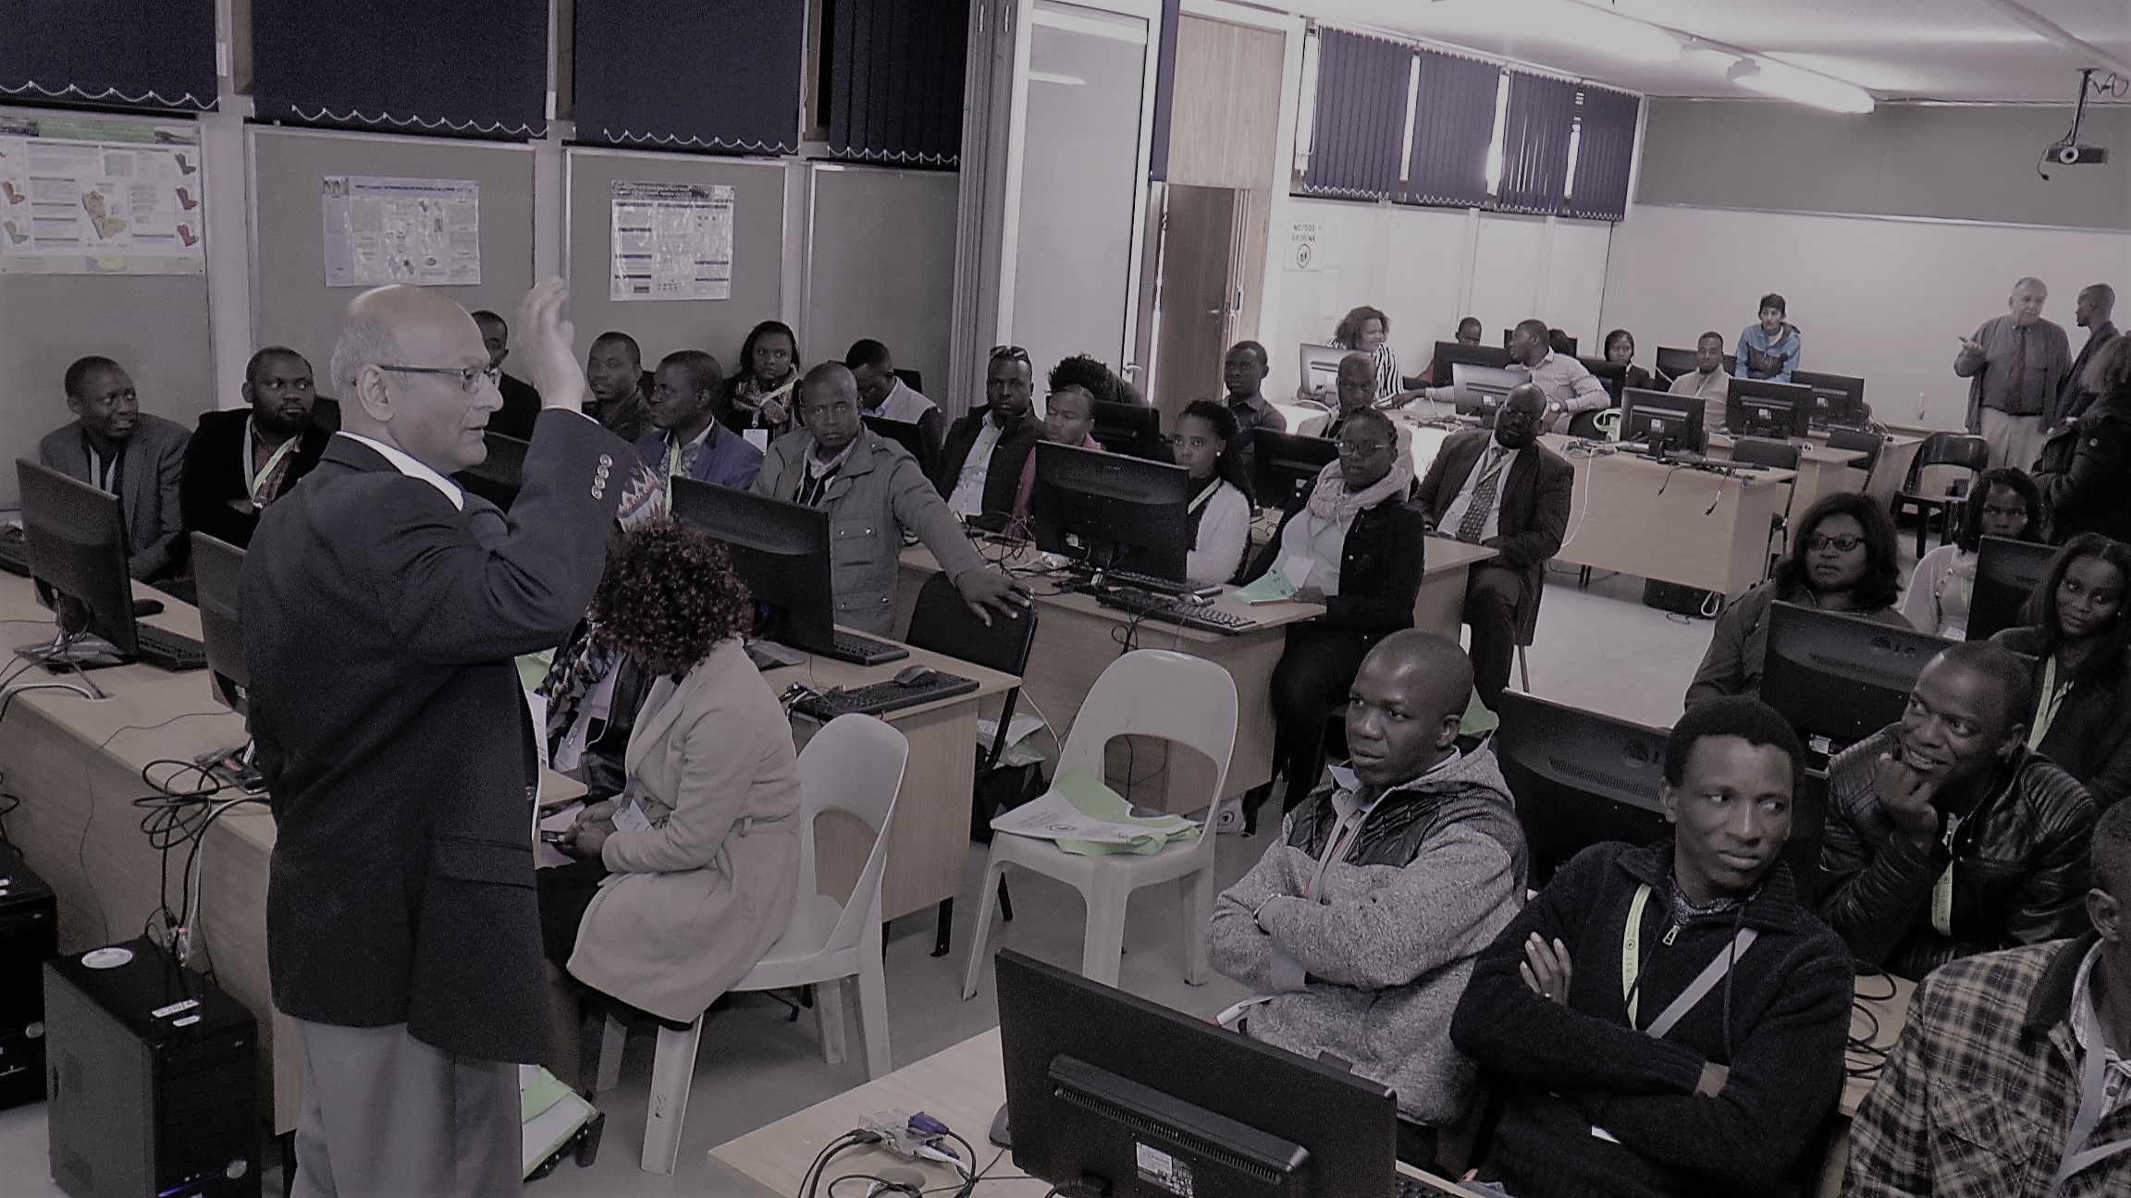
ASP2018 – teachers Program
This week July 2-6:
We have 63 teachers (all from the 14 regions of Namibia), identified by the Local Organizing Committee and the Ministry of Education, Arts & Culture
Objective:
Support teacher growth in the planning and delivering of instructions
Teachers program is running in parallel to the students program
Program designed such that the teacher could attend the ASP conference – Physics Education and Physics Communication Tracks in particular

Slide 9
Conclusions
ASP has evolved since 2010, to include
  An intensive 3-week school for students
  A workshop to train high school teachers
  An outreach to motivate high school learners
  A professional physics conference to attract ASP alumni and African research faculties
  A constant mentorship program even when there is no school
Thanks to the support and dedication of
  Sponsors
  International lecturers
  Host country governments and educational / research institutes
ASP constantly improving by
  Seeking and integrating feedbacks
  Working in synergy with other capacity development institutes operating in Africa
  Aligning ASP scientific program to better serve the education priorities of African countries

